Slide 1

Mental Health
Final Project ALY 6030
Data Warehousing and SQL
Victoria Plange

Slide 2
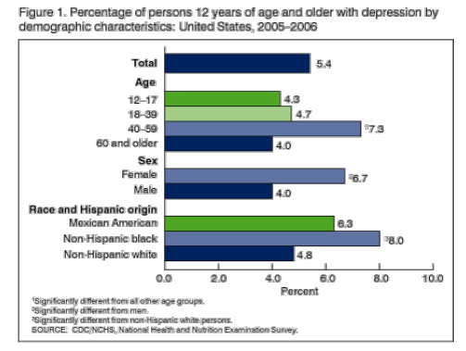

Mental Health factors
Emotional well-being (happiness, cheerfulness, peacefulness, satisfaction)
Psychological well-being (self-acceptance, personal growth, positive relationships)
Social well-being (social awareness, sense of community, self worth)
1/20 Americans age 12+ reported depression in 2005-2006

Slide 3
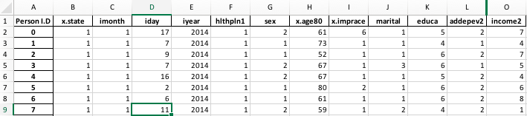
Mental Health: Depression Data
Mental health->mental illness->depression
All fields are dependent on person (i.d)

Slide 4
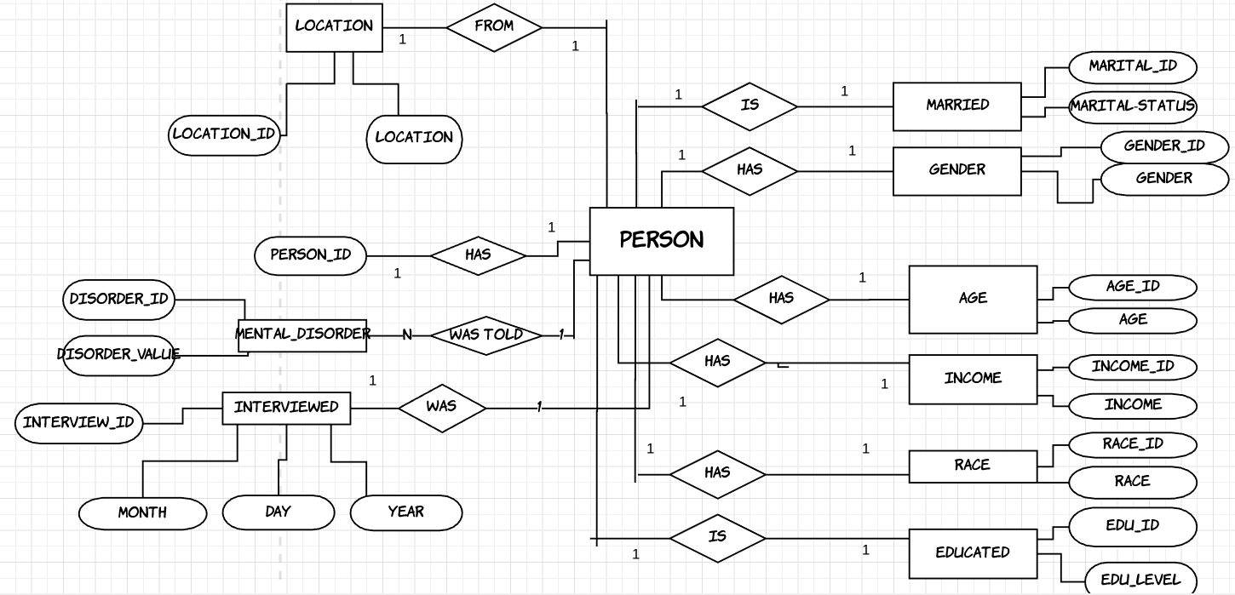
Database Structure- ERD
Primary Key: Person ID
Foreign Keys: Marital_ID, Gender_ID, Age_ID,Income_ID, Race_ID, Edu_ID,Disorder_ID, Location_ID, Interview_ID

Slide 5

Business Questions
What’s the average number of people per state who have a mental disease?
What’s the average education level of people who have been told they have mental disorder?
What’s the average income level of people who have been told they have mental disorder?
What race has the highest reported number of people with mental disorder?
What is the ratio of male to female who have been told they have mental disorder?

Slide 6
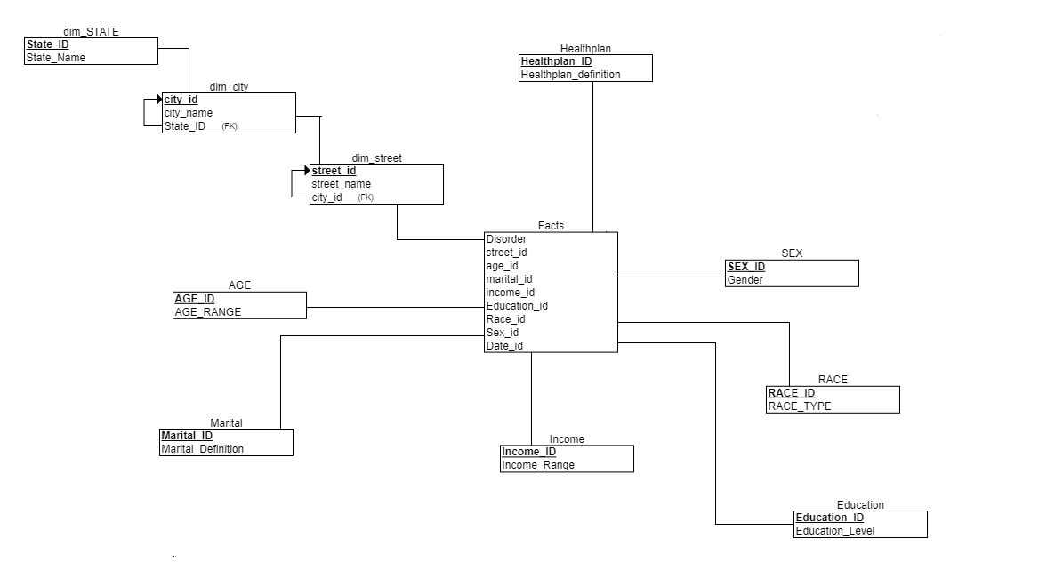
Snowflake Schema
Granularity for each sector
Location : Street of the user
Demographics : Every other field in that table since the table is normalized already. Example, for age dimension, its the field ‘age’. For race dimension, its the field ‘race’.

Slide 7
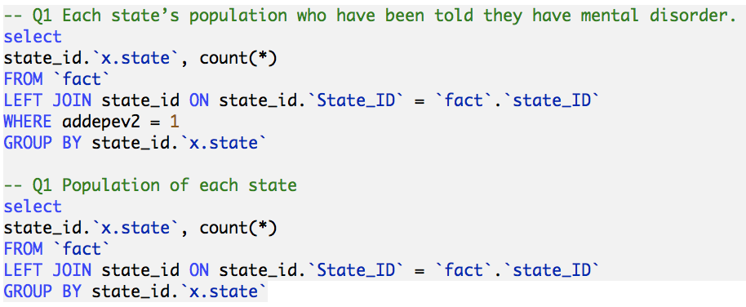
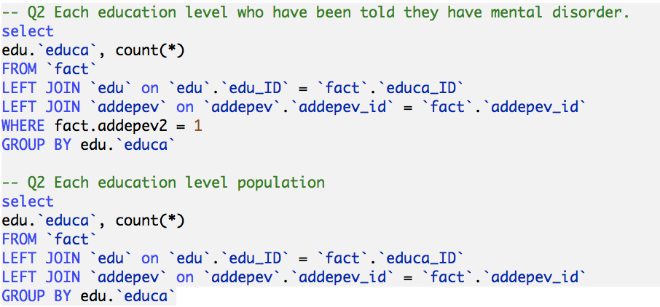
SQL Queries Normalized

Slide 8
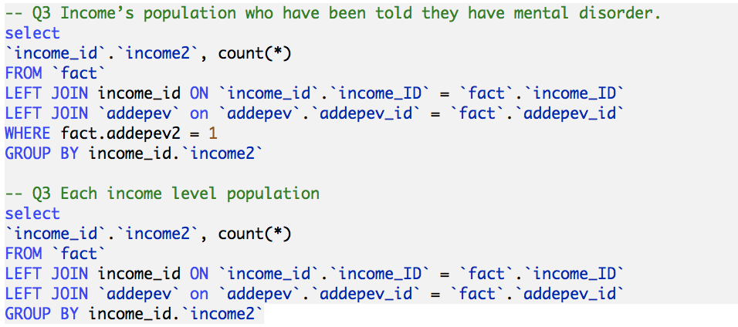
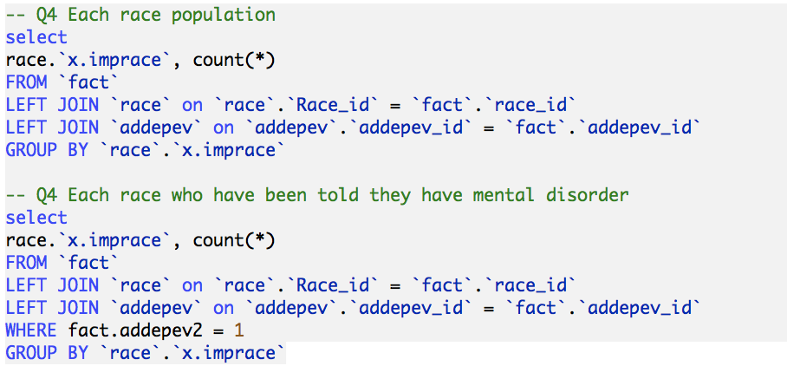

Slide 9
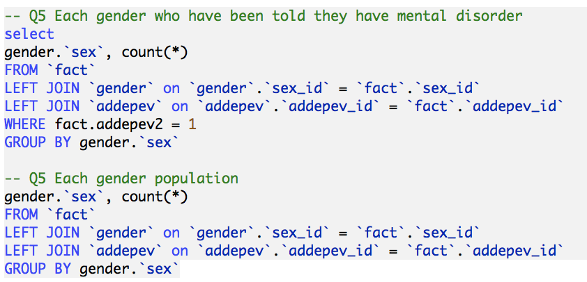

Slide 10
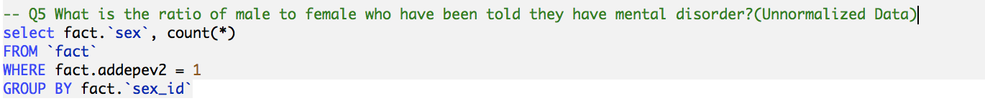
SQL Queries Unnormalized

Slide 11
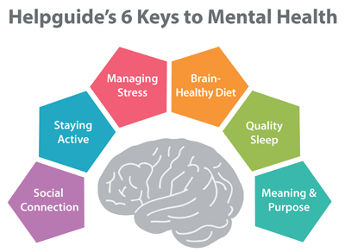
Conclusion
Building a data warehouse allows you to extract actionable insights
Allows us to have a standardized format for our data
Determine the granularity for each dimension and the right grains for different analysis

Slide 12
References
· Depression. (n.d.). Retrieved March 27, 2018, from https://www.nimh.nih.gov/health/topics/depression/index.shtml
· Depression. (2013, October 04). Retrieved March 27, 2018, from https://www.cdc.gov/mentalhealth/data_stats/depression.htm
· [Mental Health]. (n.d.). Unpublished raw data.

